Slide 1
Survival Prediction on Titanic Dataset using ML Models
Faizan Alam
Nasir Ullah Baig

Slide 2
Dataset Introduction

Slide 3
Dataset
P_id | Name | Age | Gender | Fare | Embarked | Survived
1 | Jake | 24 | Male | 7.9 | Q | 0
2 | Rose | 22 | Female | 71.3 | S | 1
3 | T.Andrews | 56 | Male | 46 | S | 0
4 | J. Jacob | 65 | Male | 33.2 | C | 0
The Titanic dataset is a classic machine learning dataset that contains information about passengers aboard the RMS Titanic, including details like age, gender, class, and whether they survived the shipwreck. It is widely used to explore classification problems and model performance evaluation

Slide 4
Dataset
PassengerId: A unique identifier for each passenger.Survived:
Survival status (0 = Did not survive, 1 = Survived).
Pclass: Passenger class (1 = First, 2 = Second, 3 = Third).
Name: Full name of the passenger.
Sex: Gender of the passenger (male/female).
Age: Age of the passenger.
SibSp: Number of siblings/spouses aboard the Titanic.
Parch: Number of parents/children aboard the Titanic.
Ticket: Ticket number.
Fare: Ticket price.
Cabin: Cabin number (often contains missing values).
Embarked: Port of embarkation (C = Cherbourg, Q = Queenstown, S = Southampton).

Slide 5
Dataset preprocessing
Handling Missing Values:
Missing values in Age were filled using the median.
Missing values in categorical features like Embarked were replaced with the most frequent value (mode).
Cabin column with significant amount of missing data was dropped to avoid skewed results.
Encoding Categorical Variables:
Gender column was converted into numerical values using Label Encoding (Male = 0, Female = 1).
Dropping Irrelevant Features:
Columns like PassengerId, Name, and Ticket were dropped as they were not relevant for survival prediction.

Slide 6
ML Models

Slide 7
Models
Decision Tree
Support Vector Machines
K-Nearest Neighbors
Splits data into branches based on feature values to make decisions in a tree-like structure.
Classifier that separates data points using a hyperplane to maximize the margin between classes.
Predicts the class of a data point based on the majority class of its nearest neighbors.

Slide 8
Data Balancing and Scaling

Slide 9
Data Balancing and Scaling
01
02
Data Balancing
Undersampling
Oversampling
Reduces the majority class by randomly removing samples to achieve class balance.
Increases the minority class by duplicating or generating synthetic samples to balance the dataset.

Slide 10
Data Scaling
Data Before Standard Scaling
Age
0.24
0.65
0.76
0.45
0.68
Age
24
65
76
45
68
Data After Standard Scaling

Slide 11
Model Training and Metrics

Slide 12
Model Training
X_train
Y_train
X_test
Y_test
80%
20%
Training Data
Testing Data
Train Data includes only numeric and hot-encoded columns.
Test Data is a series of values consisting of coresponding labels(survived).

Slide 13
Model Training
02
04
01
03
Undersampled
Data
Scaled Data
Unbalanced
Data
Oversampled
Data
Each model is trained on all versions of the dataset, including scaled, balanced, and unbalanced, to assess the results.

Slide 14
Metrics
Accuracy
F1-Score
Confusion Matrix
Classification
Report
The ratio of correctly predicted outcomes to total predictions.
The harmonic mean of precision and recall, balancing false positives and false negatives.
A table summarizing true vs. predicted classifications for all classes.
A detailed summary of metrics like precision, recall, and F1 score for each class.

Slide 15
Insights and Observations

Slide 16
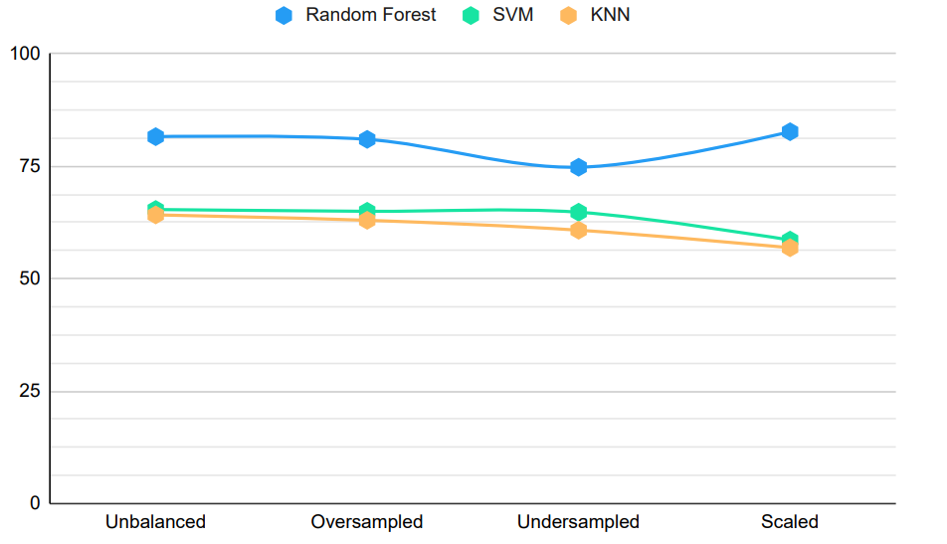
Accuracy Comparision
 | Random Forest | SVM | KNN
Unbalanced | 81.6% | 65.4% | 64.2%
Oversampled | 81% | 65% | 63%
Undersampled | 74.8% | 64.8% | 60.8%
Scaled | 82.7% | 58.6% | 56.9%

Slide 17
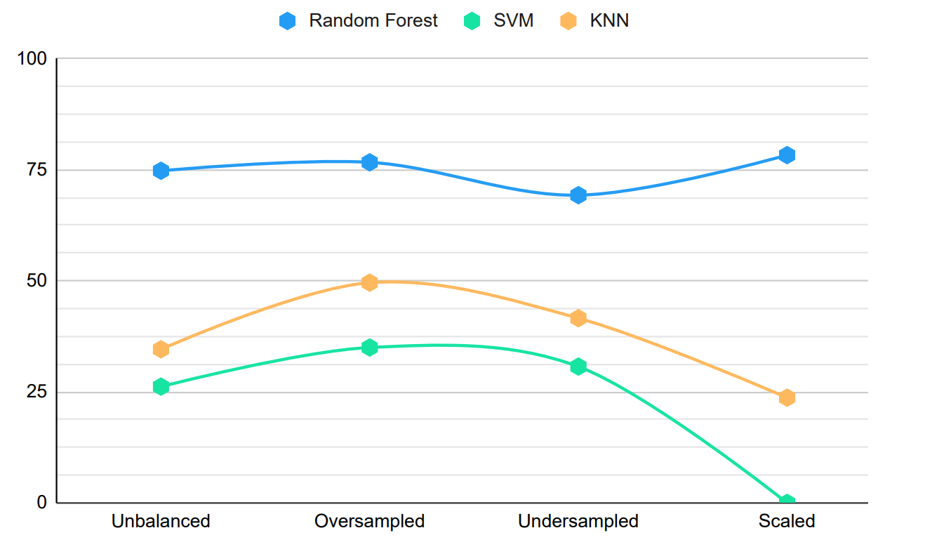
F1-Score Comparision
 | Random Forest | SVM | KNN
Unbalanced | 74.8% | 26.19% | 34.6%
Oversampled | 76.7% | 35% | 49.6%
Undersampled | 69.3% | 30.7% | 41.6%
Scaled | 78.32% | 0% | 23.7%

Slide 18
Thank You

